Slide 1
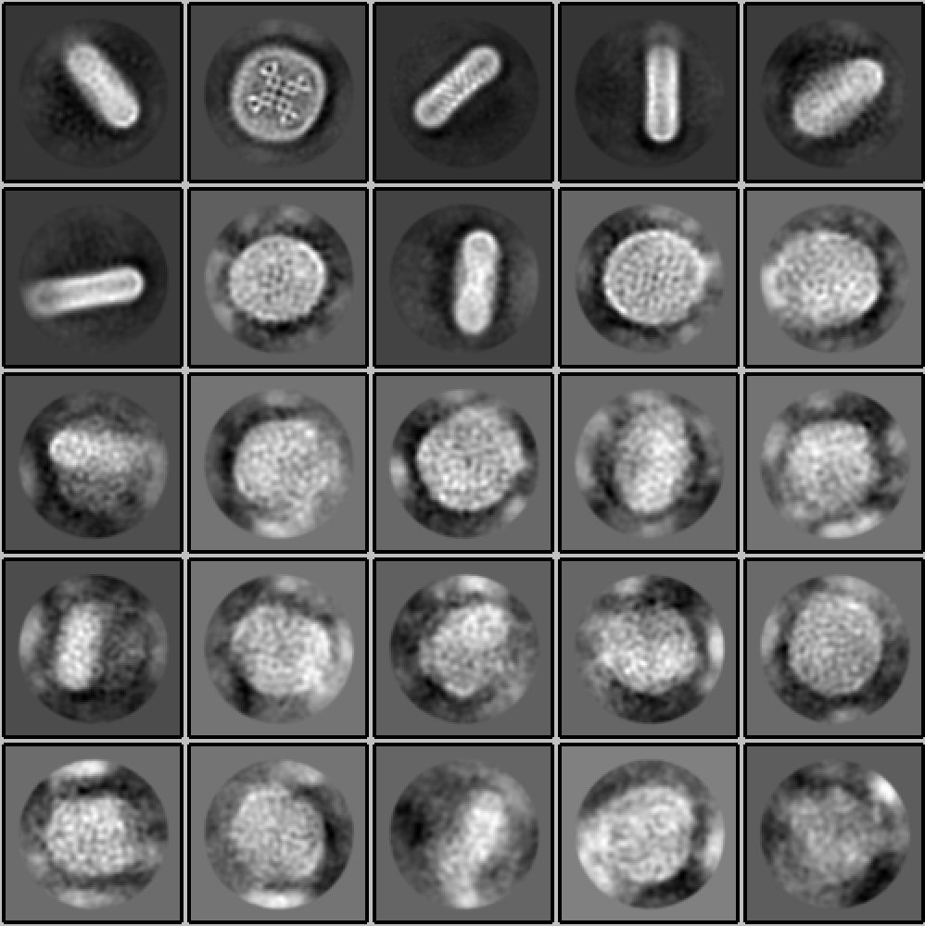
12
25
12,532 particles /
independent map
6,221 particles /
independent map
12%
12%
8%
5%
2%
© 2017 Daniel Asarnow
University of California, San Francisco
1%
Inconsistent disc-only 2D classes (25,580 particles)

